Slide 1
Reinforcement Learning

Slide 2
What is Reinforcement Learning?
RL is an area of AI/Ml in which the software (agent) makes some observations & performs some move (action) within the world (environment) and in return it gets the reward(+ve or -ve)
Sole objective : Act in such a way so that +ve rewards can be maximised

Slide 3
How RL works?
RL works by interacting with the environment.
Their no data present.
No previous training is provide to the learning agent.
Learns through trial and error method.

Slide 4
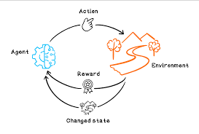
Cycle of RL

Slide 5
RL includes
Environment
Agent
Action
State
Reward
Policy

Slide 6
Agent
An agent is a decision taker who takes decision based on experience or over a policy that the agent create throughout their learning experience,

Slide 7
Environment
Environment refers to world/simulated area to which agent interacts.

Slide 8
State
Current situation of the agent in the environment.
i.e position of the chess pieces in the game of chess

Slide 9
Actions
Its a collection of probable moves.
i.e kings moves(up,down,left or right) in the game of chess.

Slide 10
Rewards
Scaler feedback to the agent so that it can learn how well its doing.
i.e giving the treat to pet after obeying commands.

Slide 11
Policy
Its an algorithm through which an agent decides its next move.
Can be like a function,look up table,Neural network.

Slide 12
Practical demo
Cart-Pole Practical Demo

Slide 13
Cartpole - Problem
Cartpole - known also as an Inverted Pendulum is a pendulum with a center of gravity above its pivot point. It’s unstable, but can be controlled by moving the pivot point under the center of mass. The goal is to keep the cartpole balanced by applying appropriate forces to a pivot point.

Slide 14
Cartpole - Problem

Slide 15
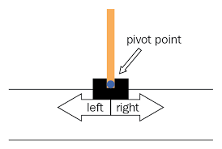
Cartpole - Problem
Open AI - Gym(Environment)
A toolkit for developing and comparing reinforcement learning algorithms”. It includes simulated environments, ranging from very simple games to complex physics-based engines, that you can use to train reinforcement learning algorithms.

Slide 16
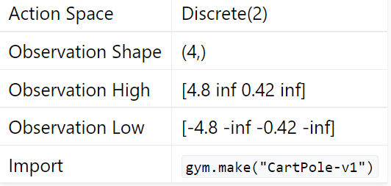
Cartpole - Problem

Slide 17
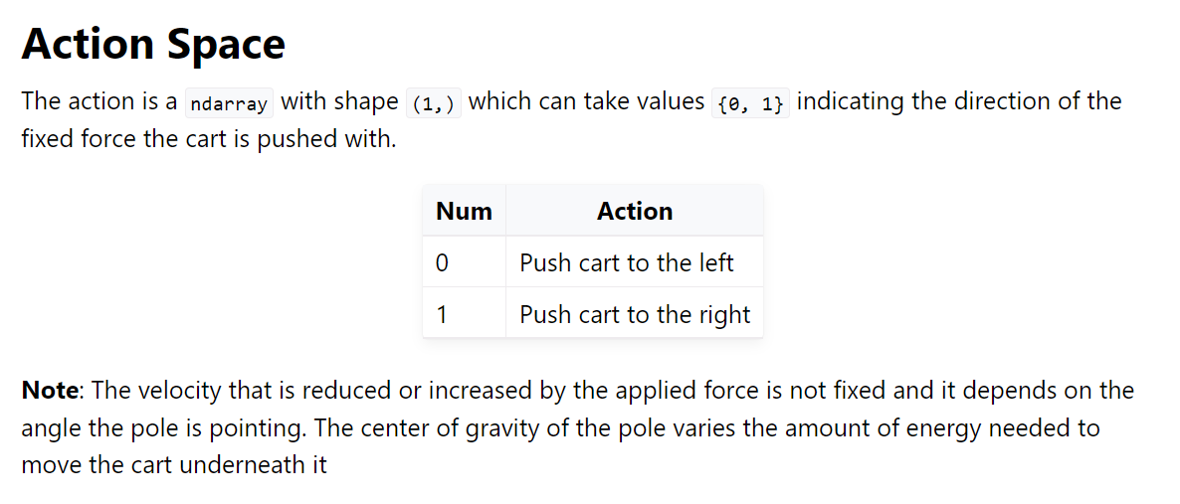
Cartpole - Problem

Slide 18
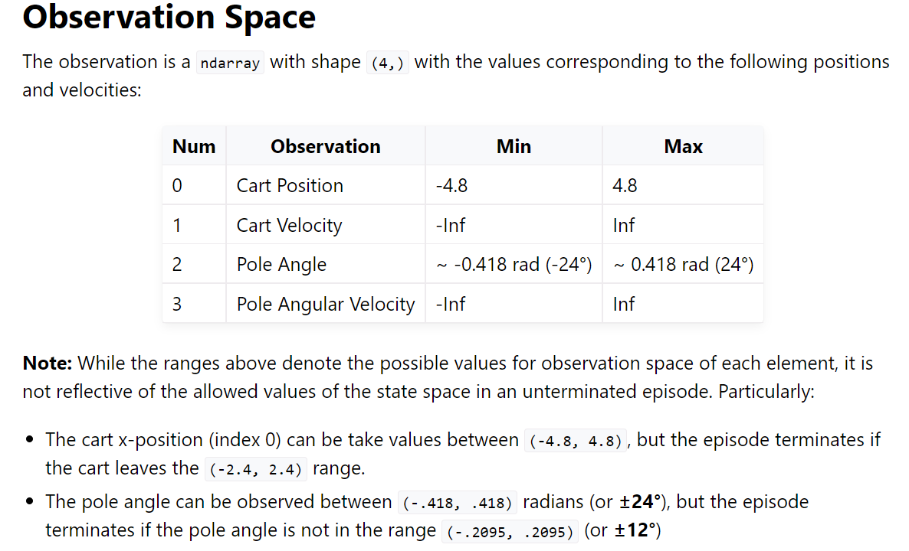
Cartpole - Problem

Slide 19
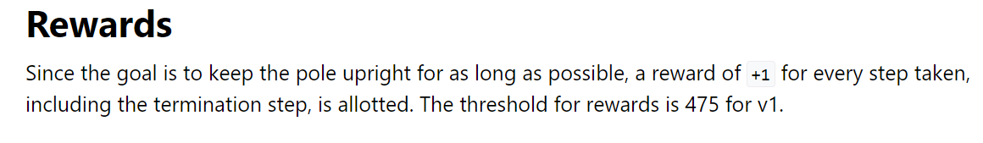
Cartpole - Problem

Slide 20
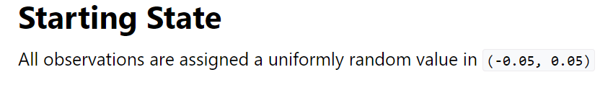
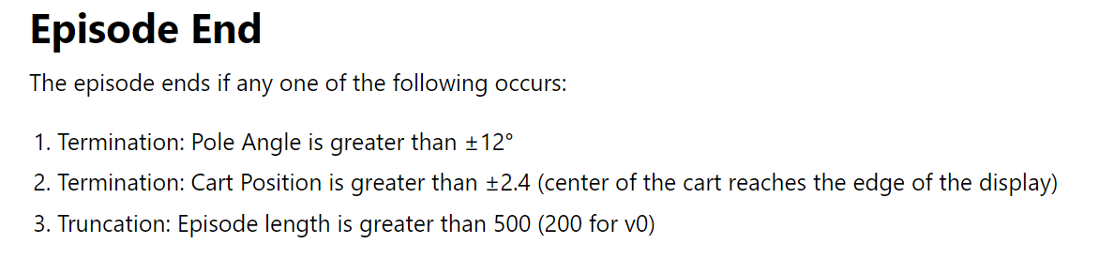
Cartpole - Problem

Slide 21
Cartpole - Problem
Basic Policy
DQN,PPO

Slide 22
Cartpole - Problem
Basic Policy
If the pole slides left , move the cart to the left.
If the pole slides right , move the cart to the right

Slide 23

Cartpole - Problem
Q-Learning(Policy)
Q-Learning is one of the more basic reinforcement learning algorithms.
Q-Learning has both positives and negatives.
Q-Learning uses previously learned “states” which have been explored to consider future moves and stores this information in a “Q-Table.

Slide 24
Cartpole - Problem
DQN(Policy)
DQN is a RL technique that is aimed at choosing the best action for given circumstances (observation). Each possible action for each possible observation has its Q value, where ‘Q’ stands for a quality of a given move.
We are calculating the new q by taking the maximum q for a given action (predicted value of a best next state), multiplying it by the discount factor (GAMMA) and ultimately adding it to the current state reward.

Slide 25
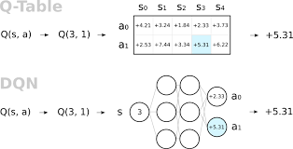
Cartpole - Problem
DQN(Policy)

Slide 26
Cartpole - Problem
PPO(Policy)
PPO is a policy gradient method and can be used for environments with either discrete or continuous action spaces. It trains a stochastic policy in an on-policy way. Also, it utilizes the actor critic method. The actor maps the observation to an action and the critic gives an expectation of the rewards of the agent for the observation given. Firstly, it collects a set of trajectories for each epoch by sampling from the latest version of the stochastic policy. Then, the rewards-to-go and the advantage estimates are computed in order to update the policy and fit the value function. The policy is updated via a stochastic gradient ascent optimizer, while the value function is fitted via some gradient descent algorithm. This procedure is applied for many epochs until the environment is solved.

Slide 27
Cartpole - Problem
Notebook

